Slide 1




DIGITAL LITERACY
SKILLS
ADVANCED USERS

Slide 2

Module 4
Content

Slide 3

1
Unit 3: Copyright and licenses

Slide 4
Main concepts: IT, ICT, and Internet
Copyright ownership gives the owner exclusive rights to use the work, with some exceptions.
When a person creates an original work, fixed in a physical form (electronic or hardcopy), they automatically own copyright to the work, for example:
audiovisual works, such as TV programmes, films and online videos
sound recordings and musical compositions
written works, such as lectures, articles, books and musical compositions
visual works, such as paintings, posters and advertisements
video games and computer software
dramatic works, such as plays and musicals.

Slide 5
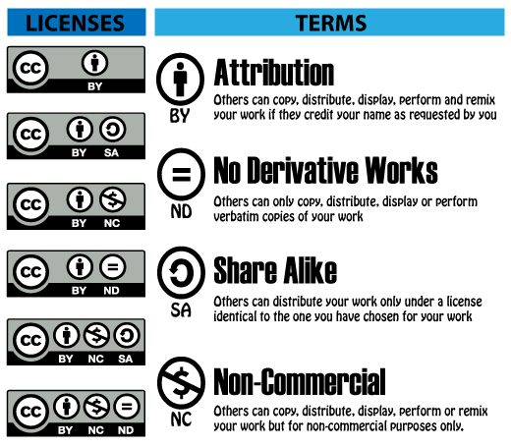
Using a copyright-protected work without infringing
It’s possible to use a copyright-protected work without breaking the owner’s copyright.
Some content owners make their work available for reuse with some limitations under a Creative Commons license.
There are six Creative Commons (CC) licenses.

Slide 6

Copyright law
Copyright law exists in all countries.
Work created in a country is subject to the copyright laws of that country and the copyright laws of the country in which it may be used.

Slide 7

Copyright law and the internet
The internet makes it very easy to copy other people’s work directly into your own document.
It’s illegal if you do not acknowledge the person who created it.
The creator is the owner of that content, so copying it and letting people think it is your own work is plagiarism, which is a form of theft.

Slide 8

Copyright law and the internet
This applies to all types of content, such as written content, images, videos, and audio recordings.
You can reuse any content you if:
you don’t sell it for profit
if you write a reference to the owner below it or next to it.

Slide 9

Online plagiarism checkers
Free plagiarism checker apps allow people to upload suspicious content for checking.
The checker compares the suspicious content with content in hundreds of similar or related documents.
It is very difficult to get past these checkers as they check and compare word for word and line by line.

Slide 10

Copyright your own work
Uganda follows international copyright agreements.
To register copyright of your own original work, go to: https://copyrightindex.com/get-copyright-registration-Uganda/

Slide 11

A list of references
When you use many sources for written assignments, footnote each reference, which is then linked to a complete list of references at the end of the assignment.
Experiment with the various options in the Footnotes and Citations & Bibliography groups on the References tab in Microsoft® Word.

Slide 12
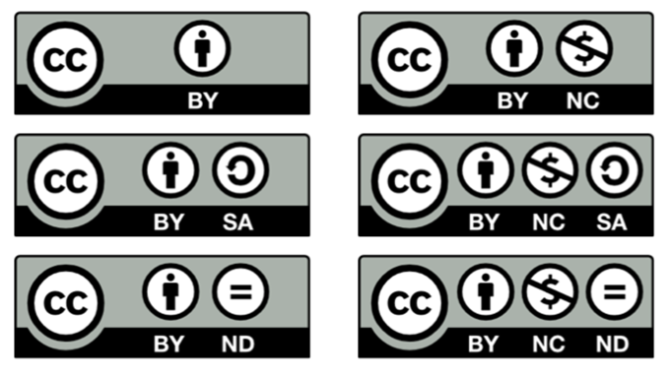
Skills to practise
Apply licenses
You are busy creating content for your website. Look at the different types of Creative Commons licenses available.
Now research the meaning of each CATEGORY HERE: https://creativecommons.org/licenses/
Decide what license you would like to apply to your website. Create a feature on your website that clearly shows the Creative Commons status.

Slide 13
All back covers should include
contact information of the section
producing the work.
© United Nations Children’s Fund (UNICEF) [month and year of publication]

